Slide 1
PROJECT PROFILE
Recent projects executed & services offered in various
Industries in many countries.
SYNERGY EXPORTS LLP.
(Engineering Division)
Off
no.
26,
floor, Galleria
4th
Bldg.
Karve Road, Kothrud
Pune, India
Synergy Exports,Pune,India
6

Slide 2
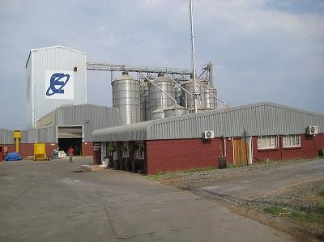
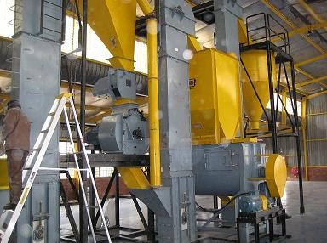
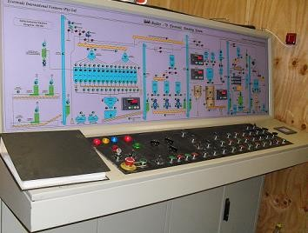
1. South
Africa : Essential Feed Mill (pty) Ltd.
Project – 250 tpd Poultry Feed Plant (PLC based) & 150 tpd cattle feed plant
with silo storage system & Boiler.
Role – Project Engineering, Consultancy, Supply & execution. Year – 2008
Plant Overview
Hammer mill & mixer
Control Panel PLC
based
Synergy Exports,Pune,India
7

Slide 3
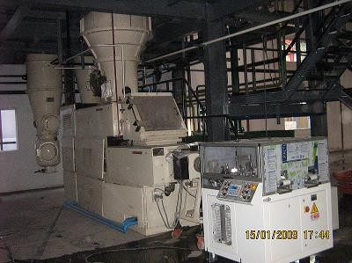
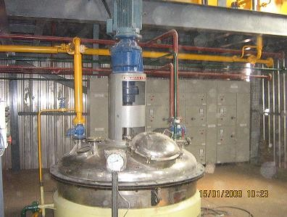
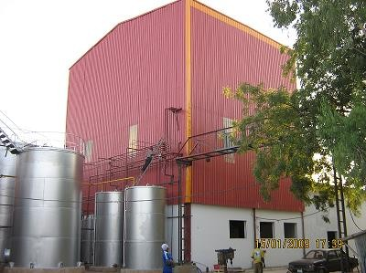
2. Nigeria : Shamantaka Industries Ltd.
Project – 75 tpd Laundry Soap & 50 tpd Toilet Soap Plants
Role - Project Engineering, Consultancy, Supply & execution. Year – 2008
Plodder
Crutcher
Synergy Exports,Pune,India
Back view & tank farm
8

Slide 4
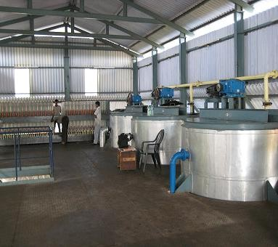
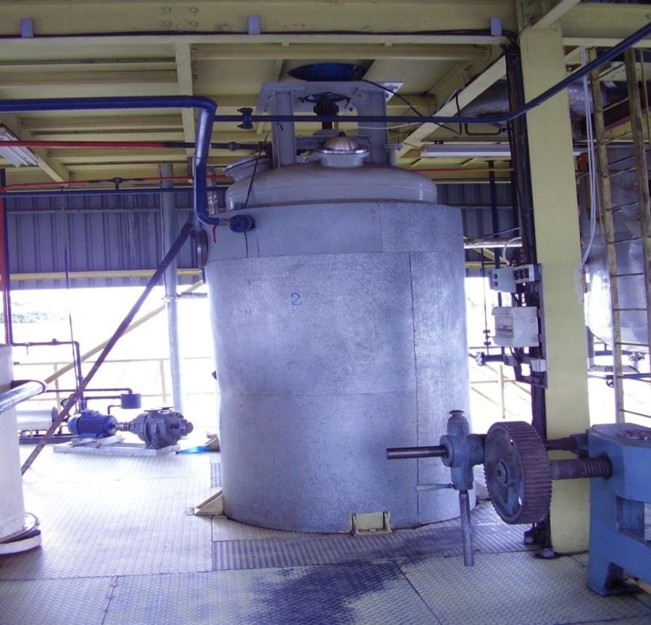
3. Burundi : Savonor SRPL
Project – 24tpd Fractionation Plant
Role – Design, Supply, Erection, commissioning. Year – 2008
Crystallizers
Neutralizer
Synergy Exports,Pune,India
9

Slide 5
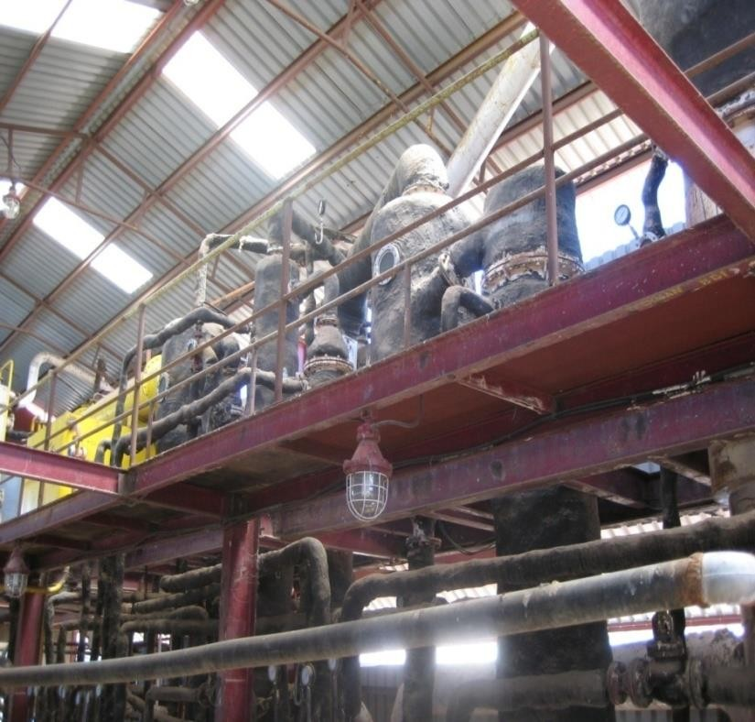
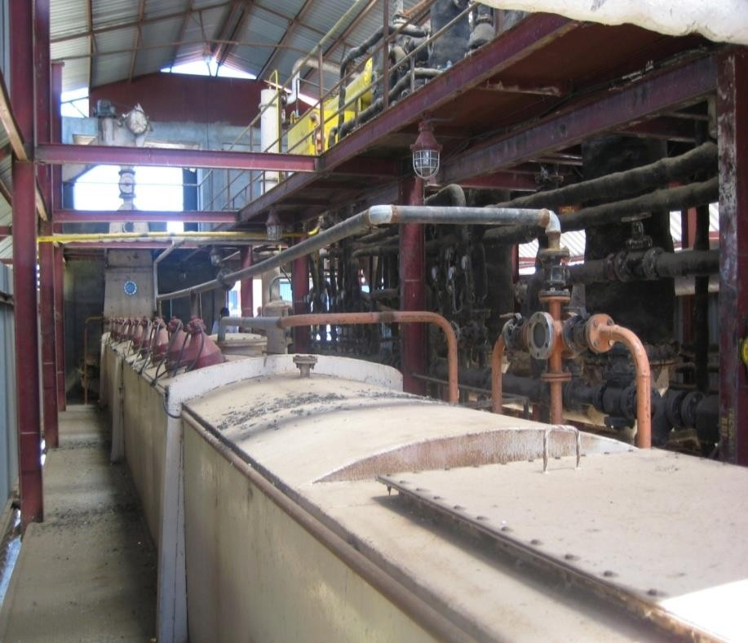
4. Tanzania : Bunda Oil Mills
Project – 200 tpd Solvent Extraction plant & 50 tpd Laundry soap Plant.
Role – Renovation, modification, commissioning & running the plant for one
year. Year – 2009
Distillation Section
Extractor
Synergy Exports,Pune,India
10

Slide 6
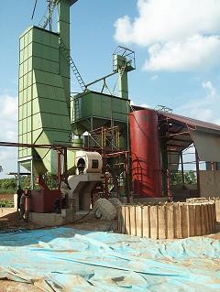
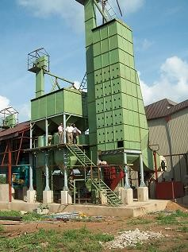
5. Nigeria :
Project – 32 tpd Rice Parboil Plant with Boiler.
Role – consultancy, Project Engineering, Supply, Erection & Commissioning. Year – 2009
6. Repeat Order
Project – 32 tpd Rice Parboil Plant with Boiler.
Role – consultancy, Project Engineering, Supply, Erection & Commissioning. Year – 2010
Blower, Heat Exchanger,
Dryer
Synergy Exports,Pune,India
11

Slide 7
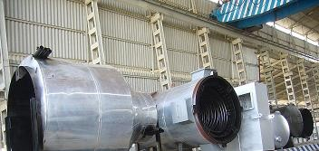
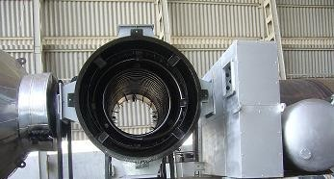
7. Guatemala : Advance Boiler
Project – 800000 K. Cal/Hr Thermic Fluid heater.
Role – Supply, erection & commissioning. Year – 2009
Thermic Fluid Heater on Board
Synergy Exports,Pune,India
12

Slide 8
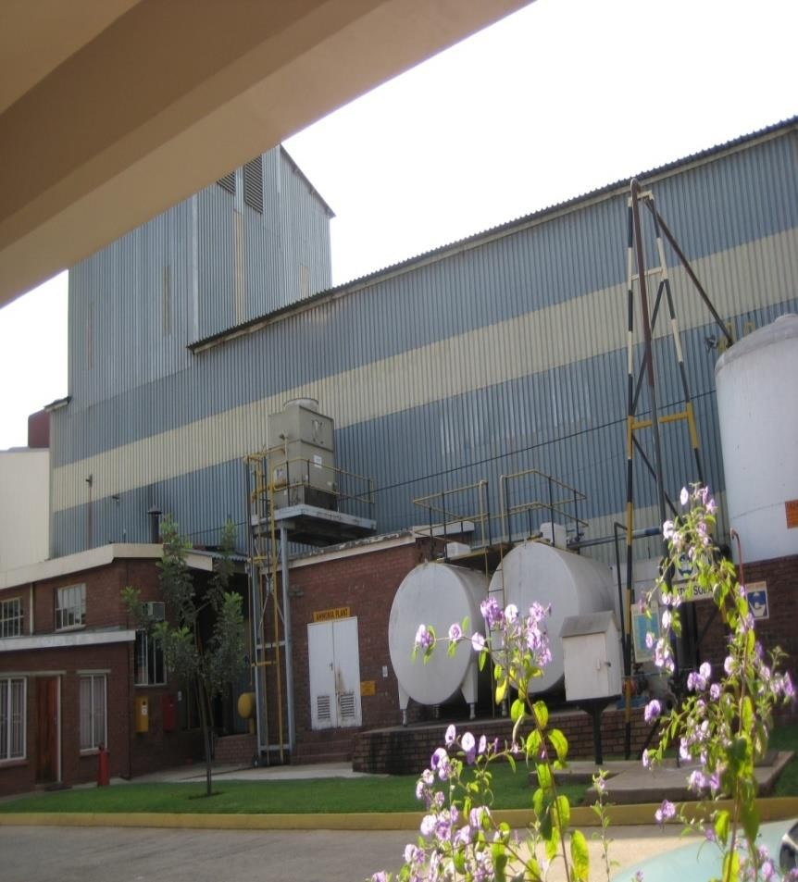
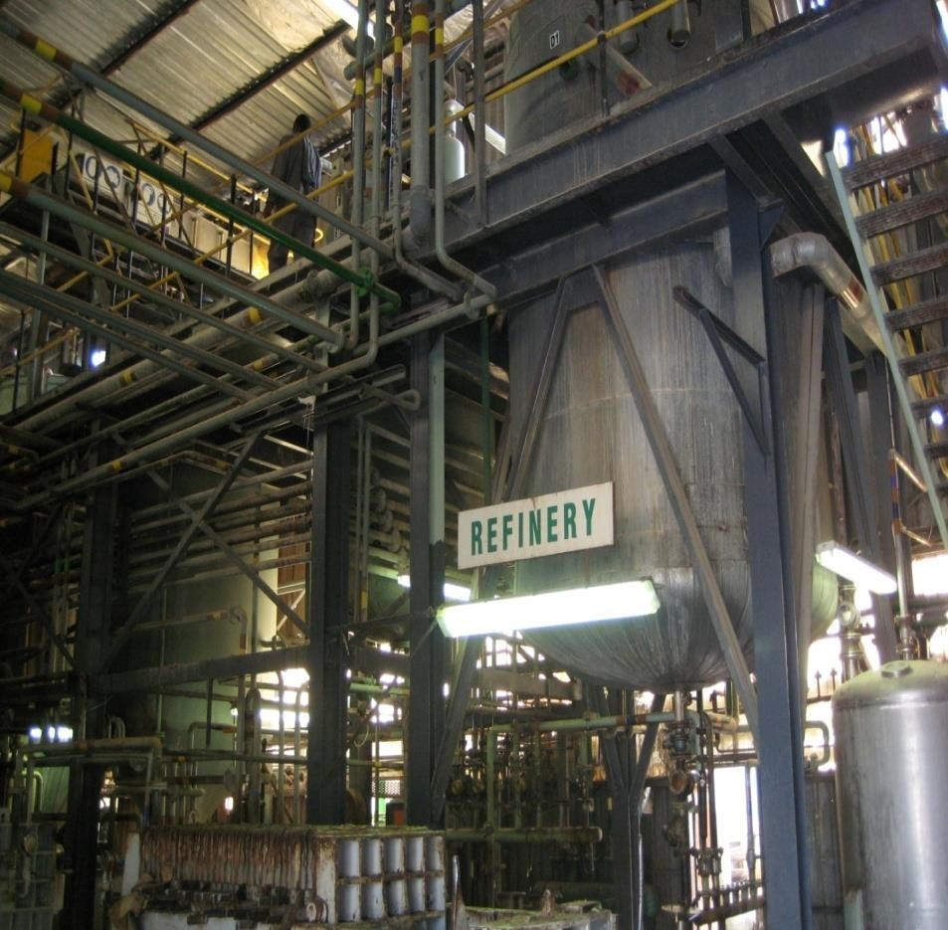
8. South Africa : Nedan Oil Mill
Project – 100 tpd continuous Edible oil refinery.
Role – Consultancy to reduce process loss & running the plant for one year.
Year – 2010
Over view
Bleaching & Deodorization
Synergy Exports,Pune,India
13

Slide 9
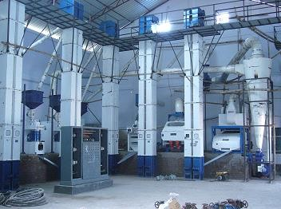
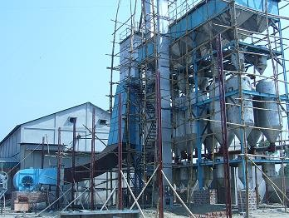
9. Bangladesh : A.K.A. Ripon
Project - 32 tpd Rice Parboiling 3 stage & 2 tph Milling Plant.
Role - consultancy, Project Engineering, Supply, Erection & Commissioning.
Year – 2010
Rice Milling
Rice parboiling 3 stage
Synergy Exports,Pune,India
14

Slide 10
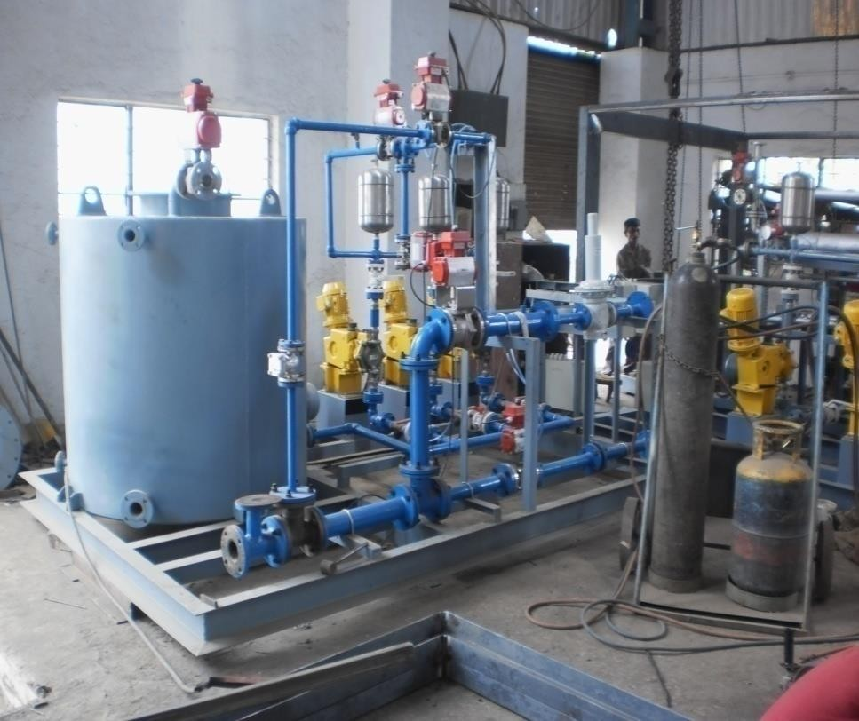
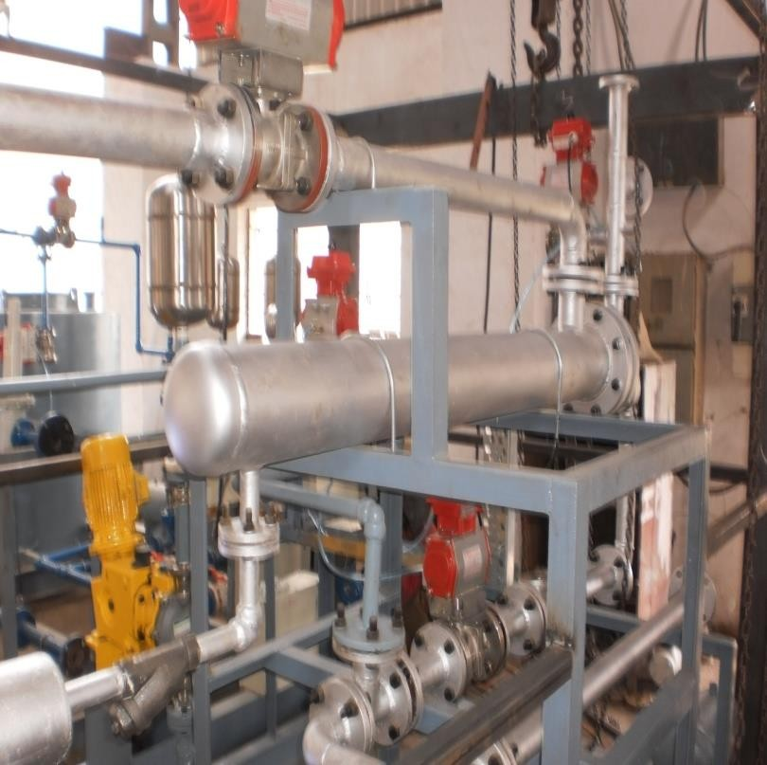
10. Nigeria : Notrore Chemical Industries
Project – Acid-Alkali Regeneration PLC based system.
Role – Supply, Erection & commissioning. Year – 2011
Ltd.
Acid regeneration
Alkali Regeneration
Synergy Exports,Pune,India
15

Slide 11
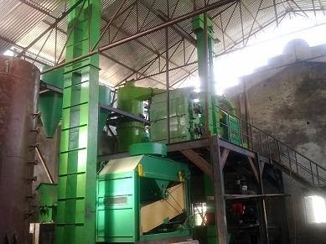
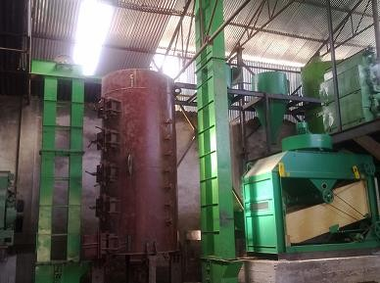
11. Nepal : Everest Solvent Pvt. Ltd.
Project – 200tpd High Protein Soya Preparatory Plant.
Role – Supply, Erection & Commissioning. Year – 2011
De huller
Cooker
Synergy Exports,Pune,India
16

Slide 12
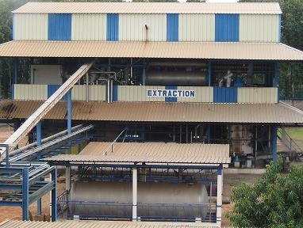
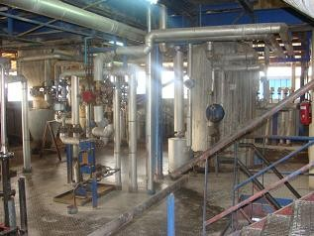
12. Benin Republic : Societe Huileries Du Benin
Project - Technical Audit, Expansion & Modification Of Cotton seed processing
complex from 250 tpd to 450 tpd. Addition of 300 tpd Soya Processing with
refinery. Role – Technical audit, Consultancy, Engineering, supply, Erection &
Commissioning.
Year – 2011
Solvent Extraction Plant Overview
SEP Inside View
Synergy Exports,Pune,India
17

Slide 13
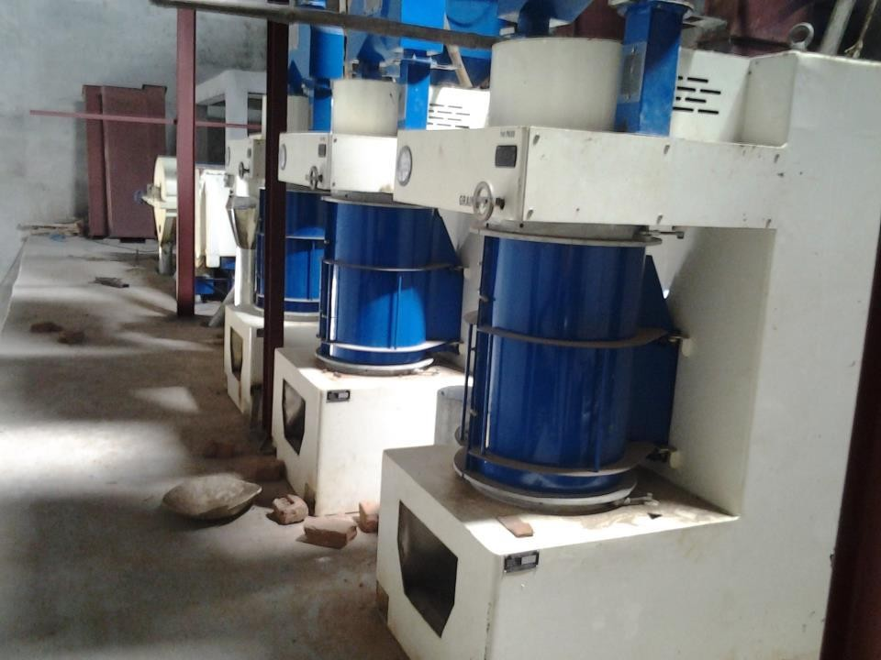
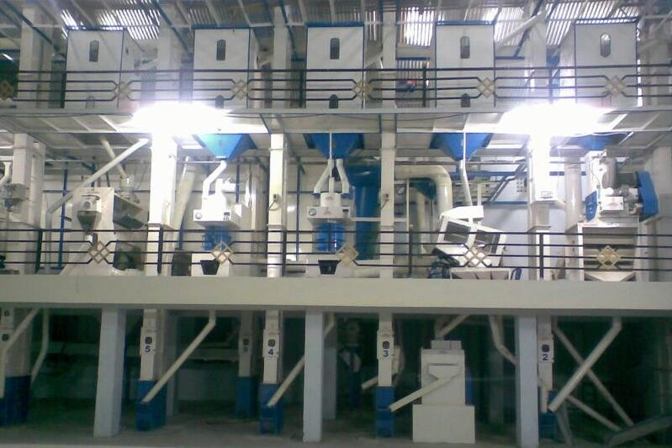
13.BANGLADESH
Project- 5 TPH Rice Milling Unit
Role: Supply
Erection
&Commissioning
Year:
2012
Synergy Exports,Pune,India
13

Slide 14
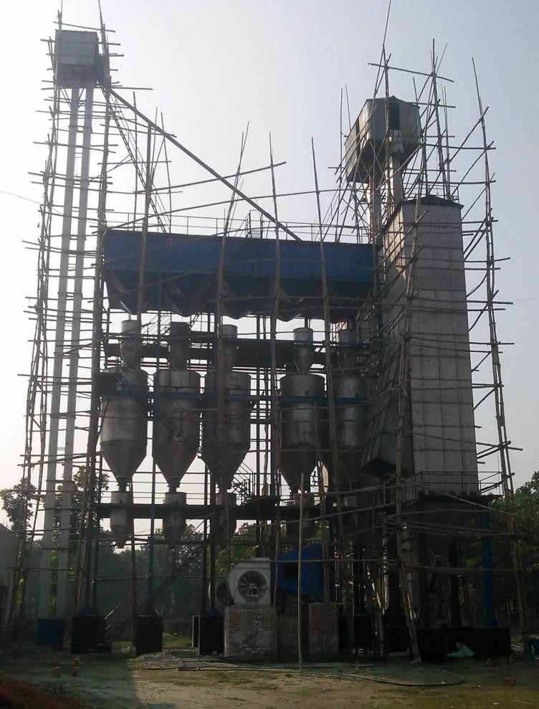
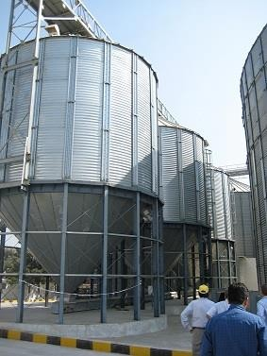
14.BANGLADESH
Project- 96 TPD Paddy Parboiling unit and
100
ton
paddy
silo
Role: Supply
Erection
&Commissioning
Year:
2013
Synergy Exports,Pune,India
14

Slide 15
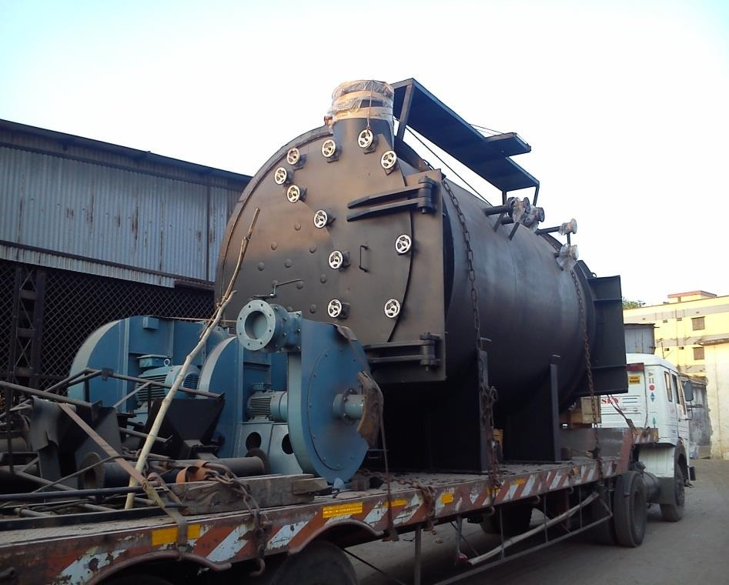
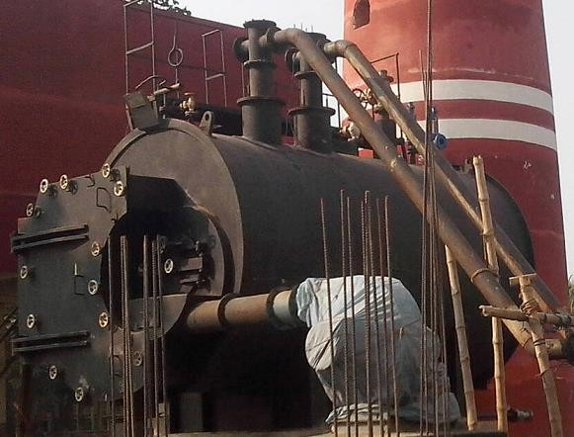
15.BANGLADESH
Project- 4 TPHX2 NOS Rice Husk fired boiler
fired boiler
and
1
TPH
Rice
Husk
Role: Supply
Erection
&Commissioning
Year:
2013
Synergy Exports,Pune,India
15

Slide 16
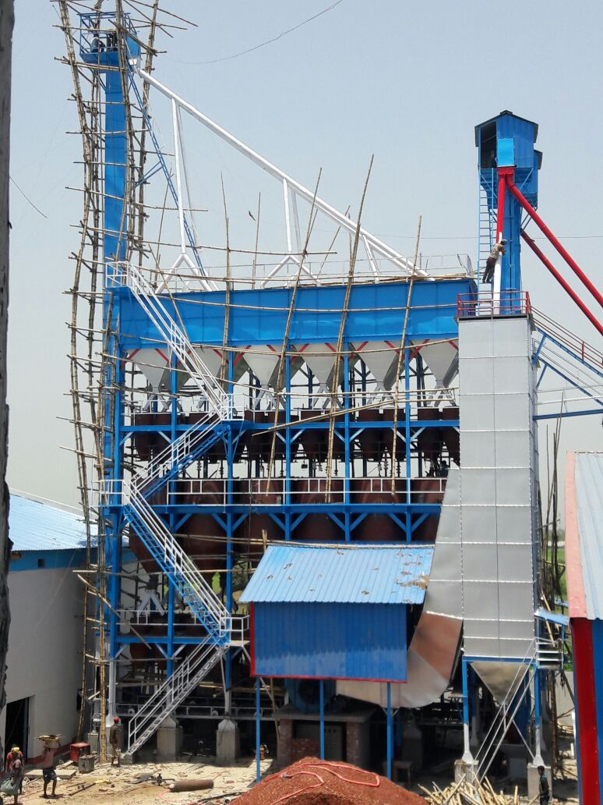
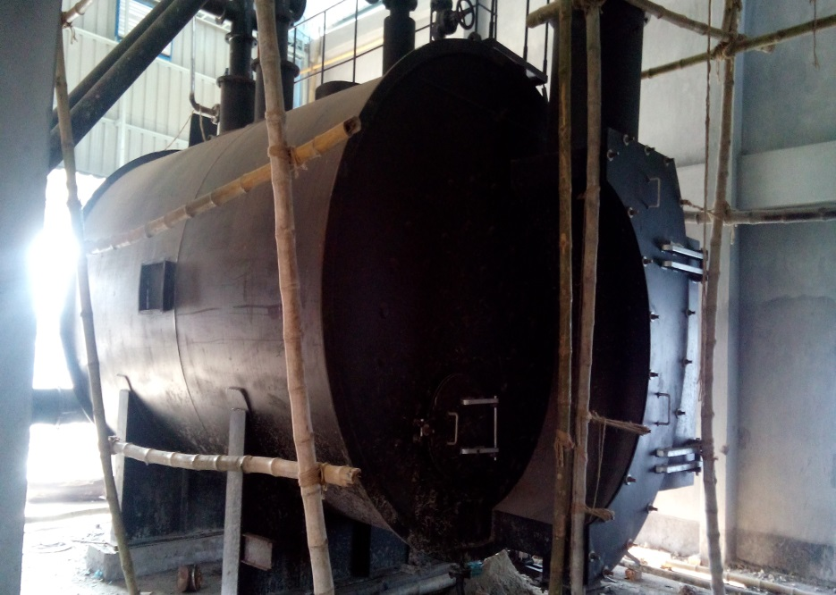
16. BANGLADESH
Project- 96 TPD Paddy Parboiling unit and 5 TPH Boiler
Role – Supply, Erection & Commissioning
Year Of Supply - 2015

Slide 17
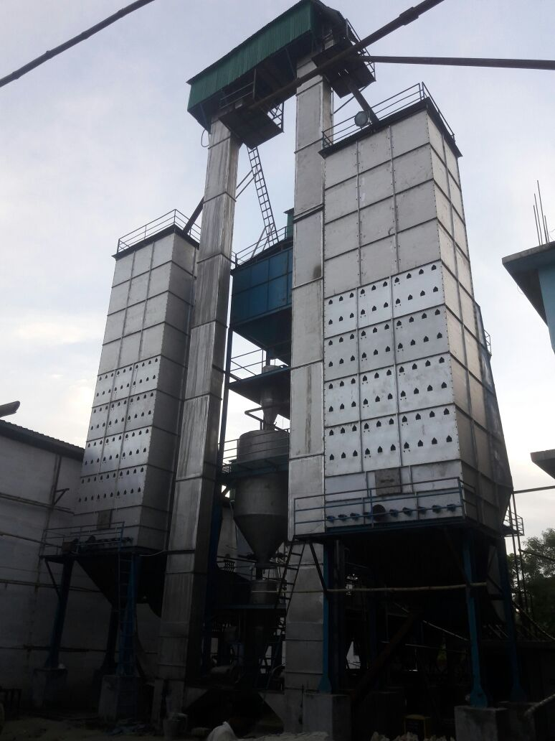
17. BANGLADESH
Project- 96 TPD Paddy Parboiling unit
Role – Supply, Erection & Commissioning
Year Of Supply - 2015

Slide 18
17. Tanzania
Project- Plant for Preparation of Oil & Refinery
Role – Supply,
Year Of Supply - 2015

Slide 19
THANK
YOU
Synergy Exports,Pune,India
16

